Slide 1
Graduate Students: Project Reminder
Midpoint due is on Nov. 15 (< 3 weeks from now)
Midpoint presentations on Mon, Nov. 15.
Guidelines will be released this weekend
Make progress every day.
Keep a notebook & write as you go, so that you are not writing both the report and making the slides at the last minute.

Slide 2
CS 295B/CS 395B Systems for Knowledge Discovery
Demographics of AMT

Slide 3
Topics for today
Why should we care about the demographics of AMT in the first place?
What are the demographics of AMT?
Context for Monday’s reading.

Slide 4
Why should we care?

Slide 5
What do we mean by demographics?
Features of crowd workers
Age, Ethnicity, Gender
Mother tongue
Employment status
Social Science/Ethnographic research
AI/ML research
Draw ER diagram on the board

Slide 6
What do we mean by demographics?
Features of crowd workers
Age, Ethnicity, Gender
Mother tongue
Employment status
Obvious why we should care
Social Science/Ethnographic research
AI/ML research

Slide 7
What do we mean by demographics?
Features of crowd workers
Age, Ethnicity, Gender
Mother tongue
Employment status
Less obvious why we should care
Social Science/Ethnographic research
AI/ML research

Slide 8
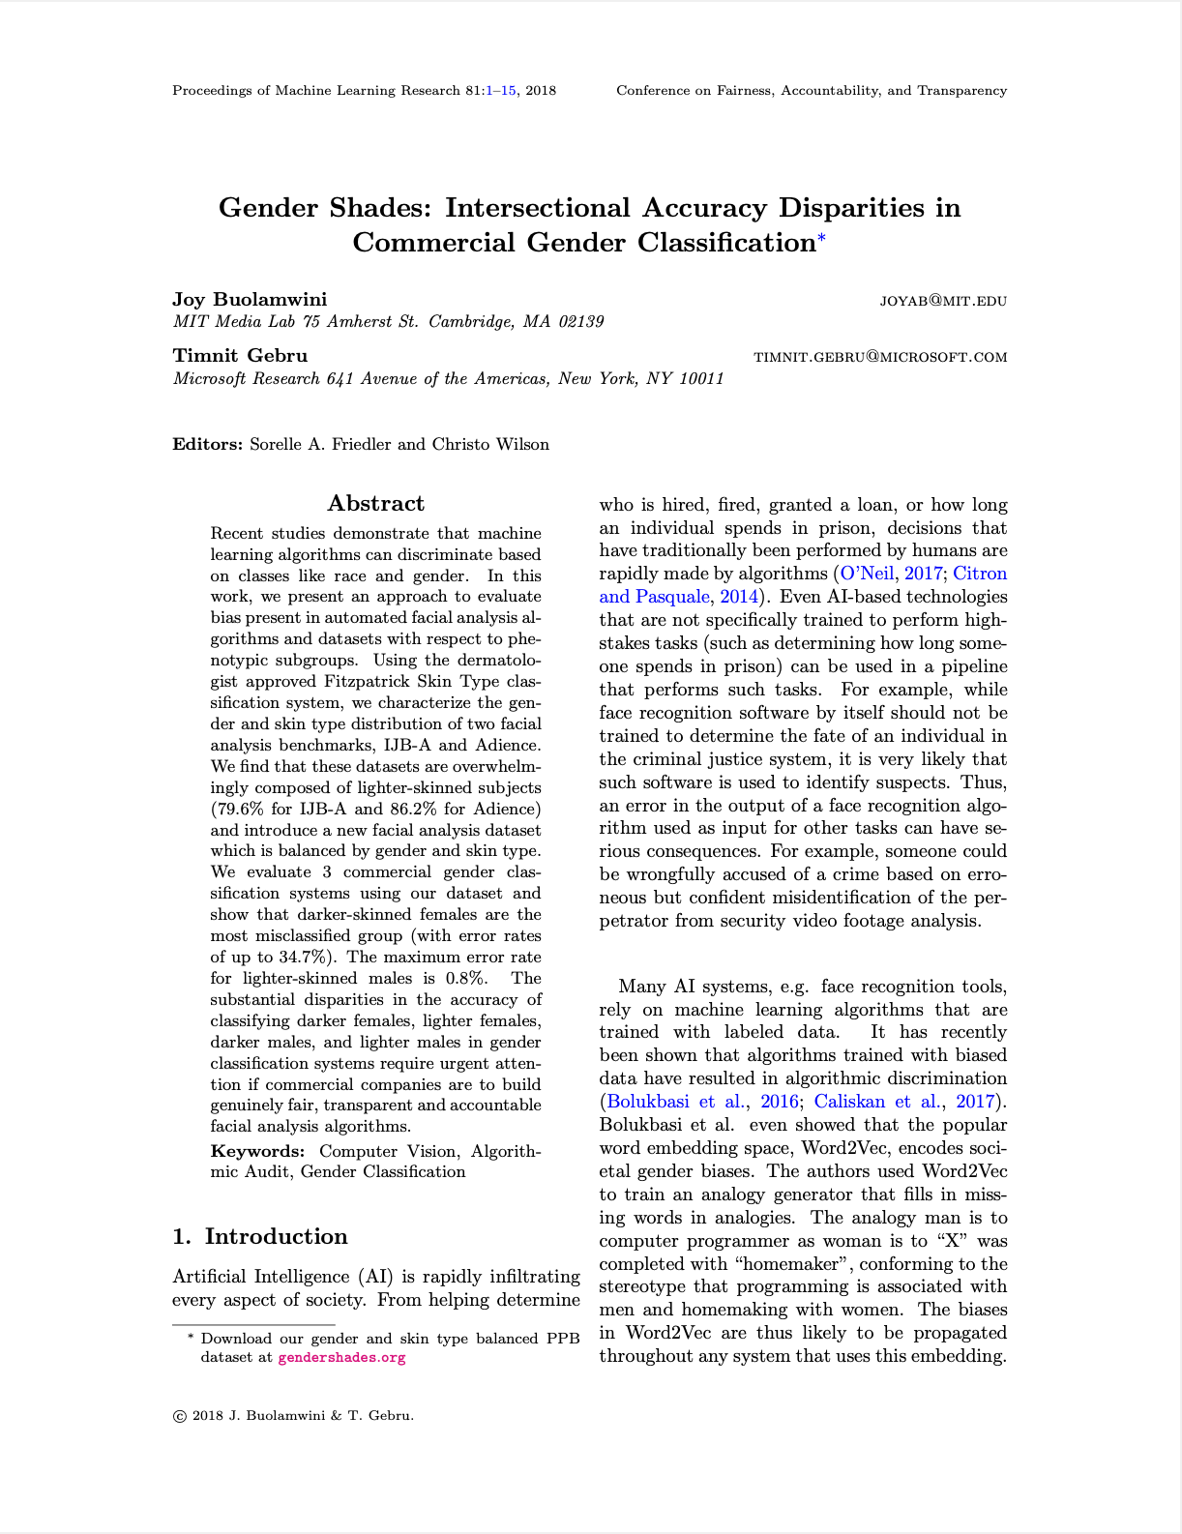
Paper idea: empirical analysis of gender classification for computer vision
Findings: Poor performance for women, abysmal performance for dark-skinned women
Great methodology,
Great findings

Slide 9
Paper idea: empirical analysis of gender classification for computer vision
Findings: Poor performance for women, abysmal performance for dark-skinned women
Important for other reasons, too!
Mainly attributed to class imbalance

Slide 10
Paper idea: empirical analysis of gender classification for computer vision
Findings: Poor performance for women, abysmal performance for dark-skinned women
Prior work in NLP on bias

Slide 11
Paper idea: empirical analysis of gender classification for computer vision
Findings: Poor performance for women, abysmal performance for dark-skinned women
Prior work in NLP on bias
This work started discourse on bias in variable construction

Slide 12
Classic Causal Assumption
label
data

Slide 13
New Causal Assumption
data
label
label

Slide 14
New Causal Assumption
collection
data
label
demos.
label

Slide 15
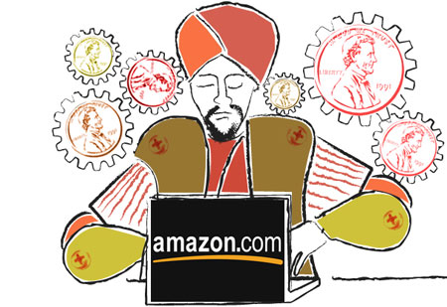
Why does this matter?

Slide 16
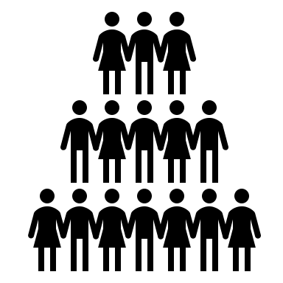

Why does this matter?

Slide 17
What are the demographics?

Slide 18
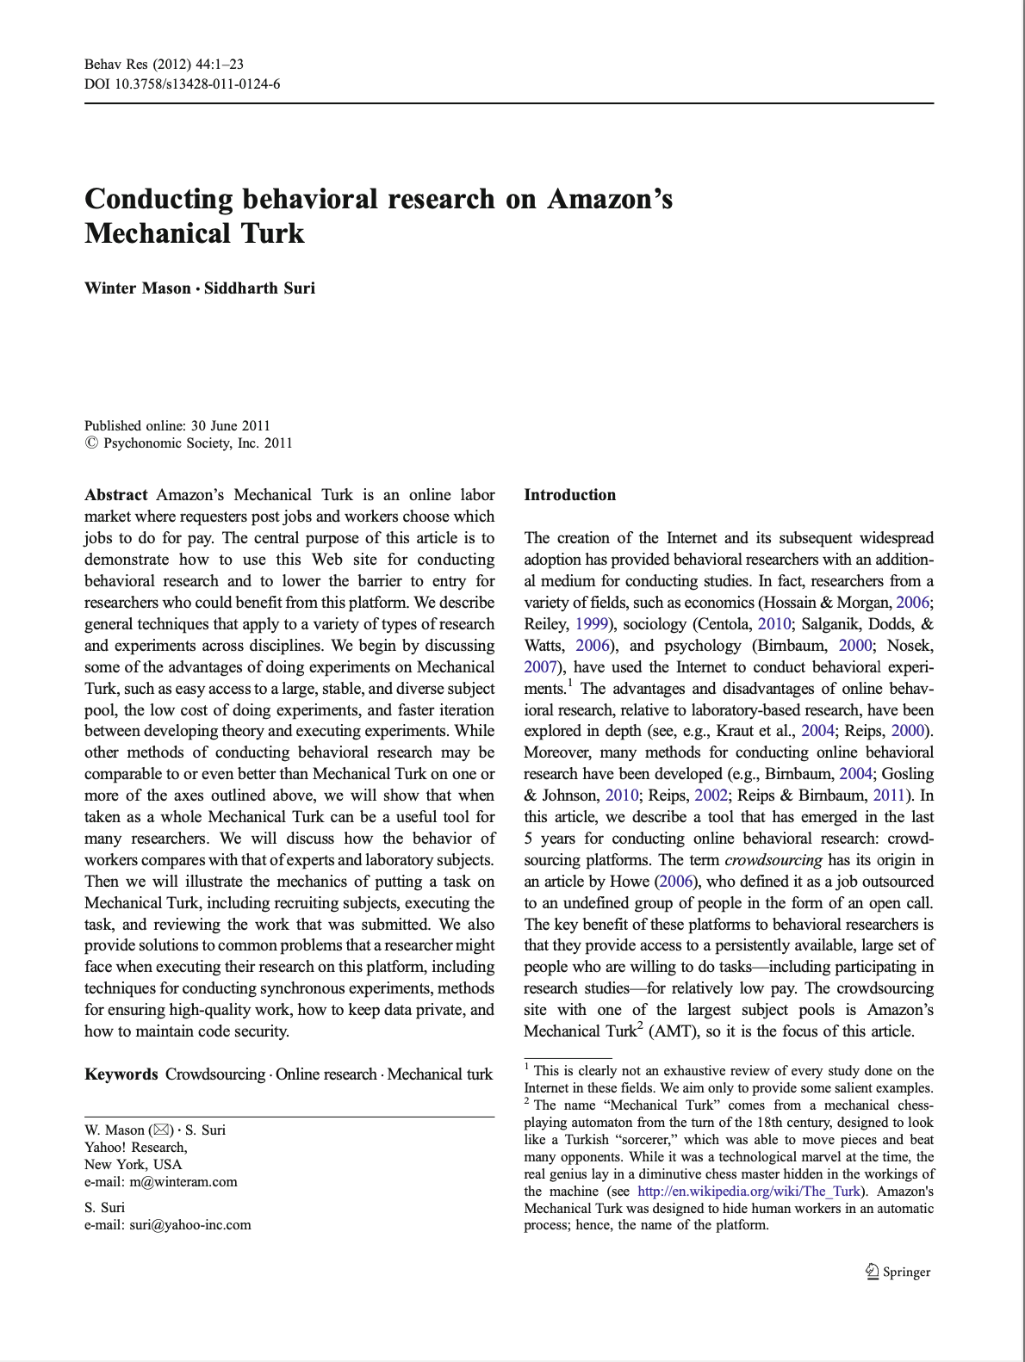
Turkers over time
AMT opened: 2005
A lot has changed in 15 years
Many early demographic studies: 2010-2015

Slide 19
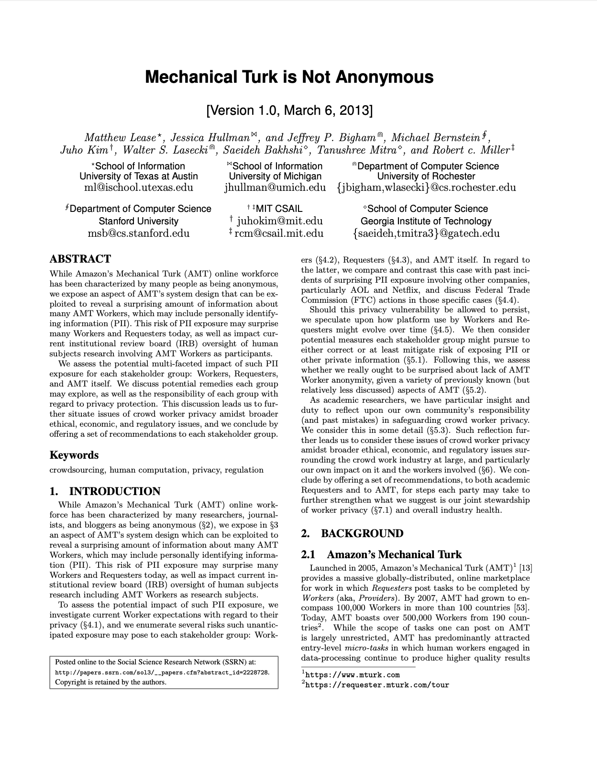
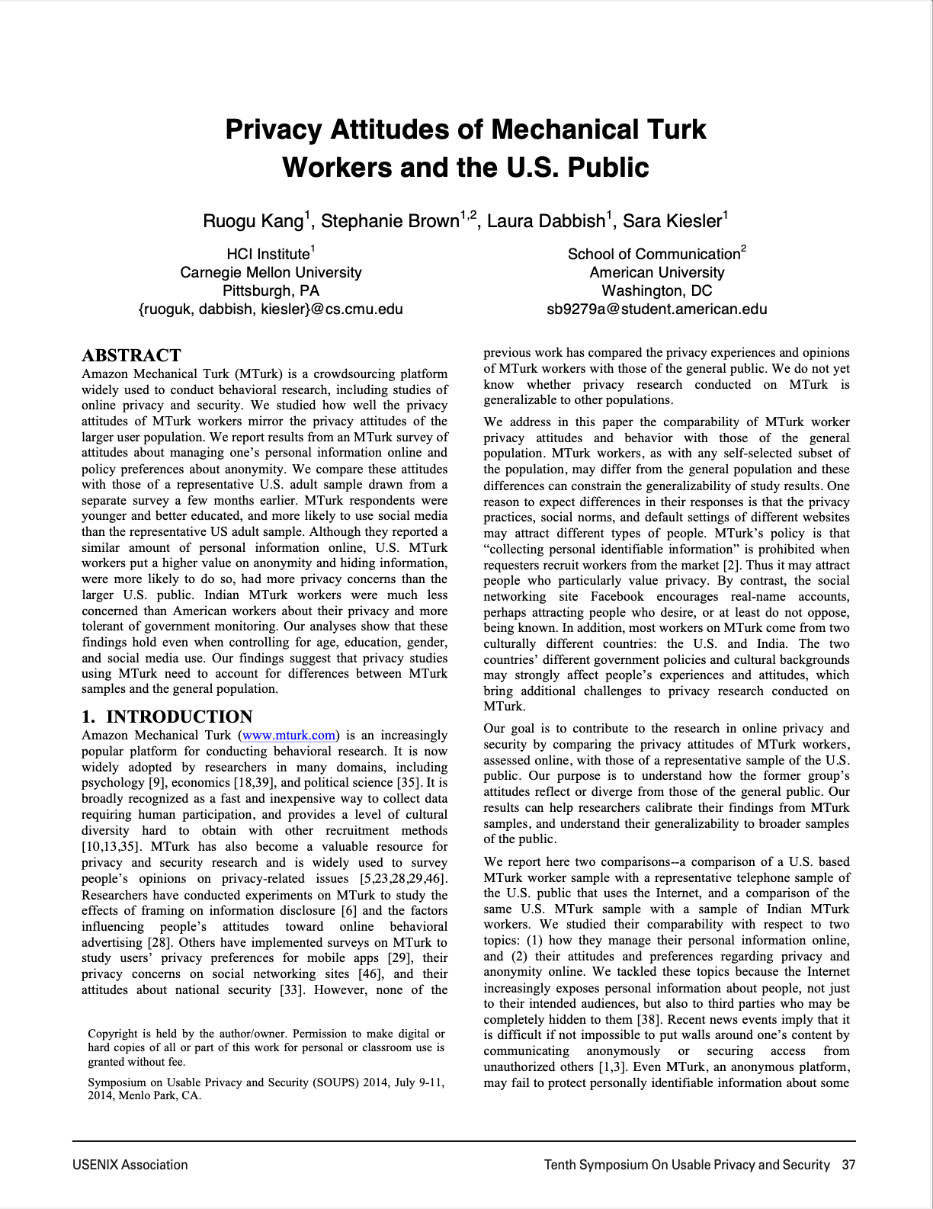
Myth: Turkers are anonymous
We studied how well the privacy attitudes of MTurk workers mirror the privacy attitudes of the larger user population. We report results from an MTurk survey of attitudes about managing one’s personal information online and policy preferences about anonymity. We compare these attitudes with those of a representative U.S. adult sample drawn from a separate survey a few months earlier. MTurk respondents were younger and better educated, and more likely to use social media than the representative US adult sample. Although they reported a similar amount of personal information online, U.S. MTurk workers put a higher value on anonymity and hiding information, were more likely to do so, had more privacy concerns than the larger U.S. public. Indian MTurk workers were much less concerned than American workers about their privacy and more tolerant of government monitoring. Our analyses show that these findings hold even when controlling for age, education, gender, and social media use. Our findings suggest that privacy studies using MTurk need to account for differences between MTurk samples and the general population.
SSRN 2014
SOUPS 2014

Slide 20
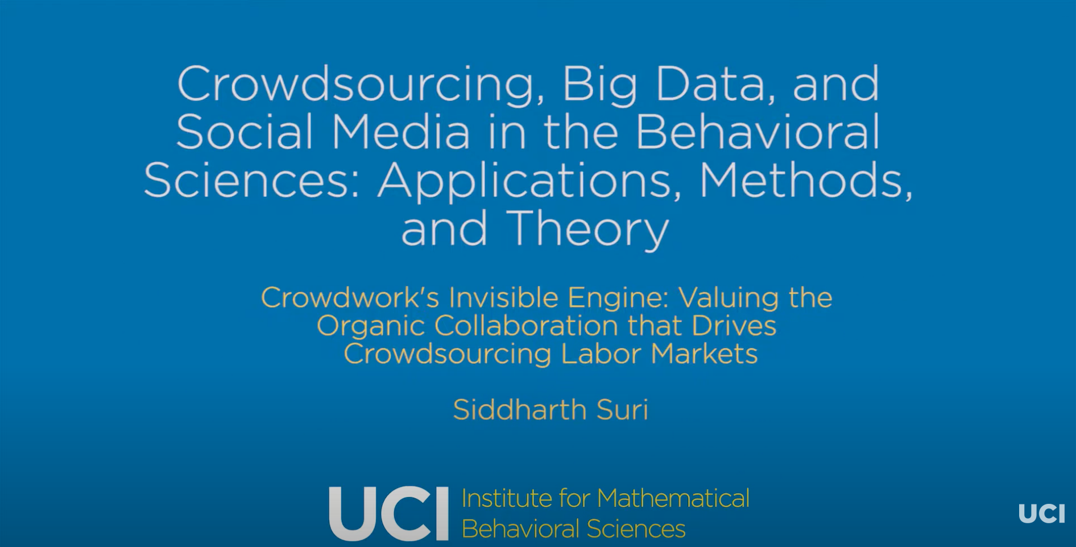
Talk by Sid Suri (computer scientist @ Microsoft Research)
Collaboration with work Mary Gray (ethnographer @ Microsoft Research)
https://www.youtube.com/watch?v=rWSGFA-jme0

Slide 21
Talk by Sid Suri (computer scientist @ Microsoft Research)
Collaboration with work Mary Gray (ethnographer @ Microsoft Research)
80% US-based
Indian Turkers highly collaborative
Most Turkers have other work
High degree of heterogeneity in how system is used
https://www.youtube.com/watch?v=rWSGFA-jme0

Slide 22
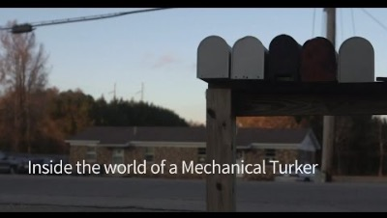

Slide 23
Context for Monday’s readings

Slide 24
The story of my paper
Research doesn’t happen the way it’s written in papers
Original idea: compiling Automan programs*
List of big problems in crowdsourcing from Sid Suri
Accepted on first submission
* Aside: How we think about labor has changed

Slide 25
Aside: Academic IRBs and AMT
IRBs are NOT ethics review boards
Student question on Automan: was this granted IRB approval?
Proposals to use AMT must be submitted for IRB approval.
However, de-identified crowdwork usually considered exempt.
(SurveyMan ran with a consent form + my contact information)

Slide 26
How do we learn about Turkers
Tough nut to crack…
Idea: Use machine learning and multiple data sets to deduce their identities and demographic information from their Amazon ids?
JK/LOL
Just f*cking ask them.
Option A: survey
Option B: interview

Slide 27
Variability in Methodological Training
Important to reflect on research cultures
Systems building
security
threat model: adversarial behavior
assumption: start from a place of no trust
Social science
ethnography
thread model: measurement error
assumption: trust is easy to lose

